Slide 1
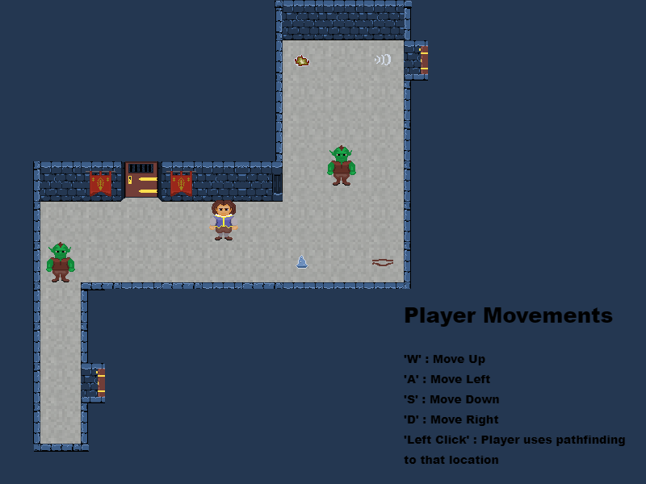
Dagger’s Gate
Pitch Date: 1/31/2021
Release Date: 5/23/2021
Team Lead: Vince McKeown

Slide 2
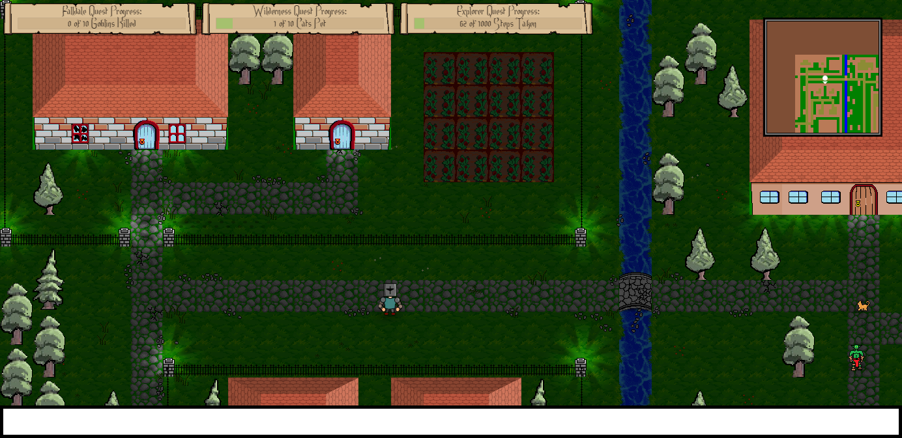
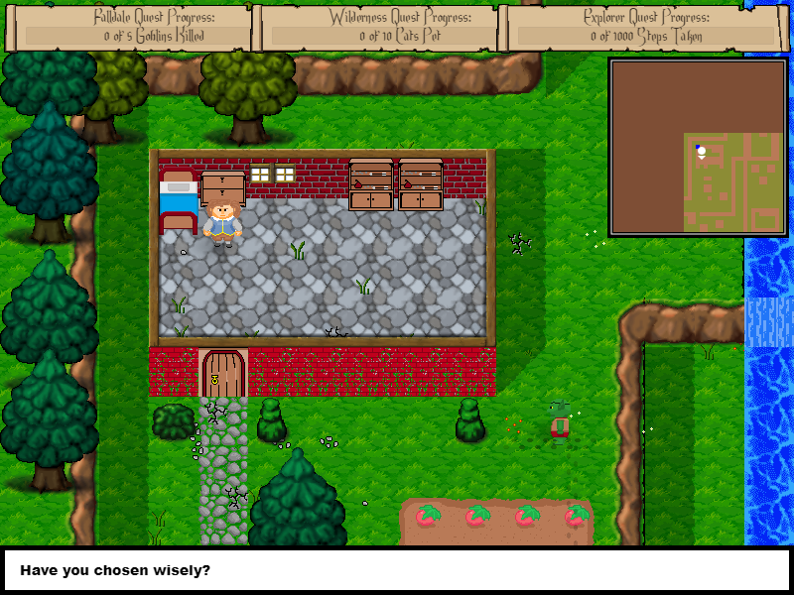
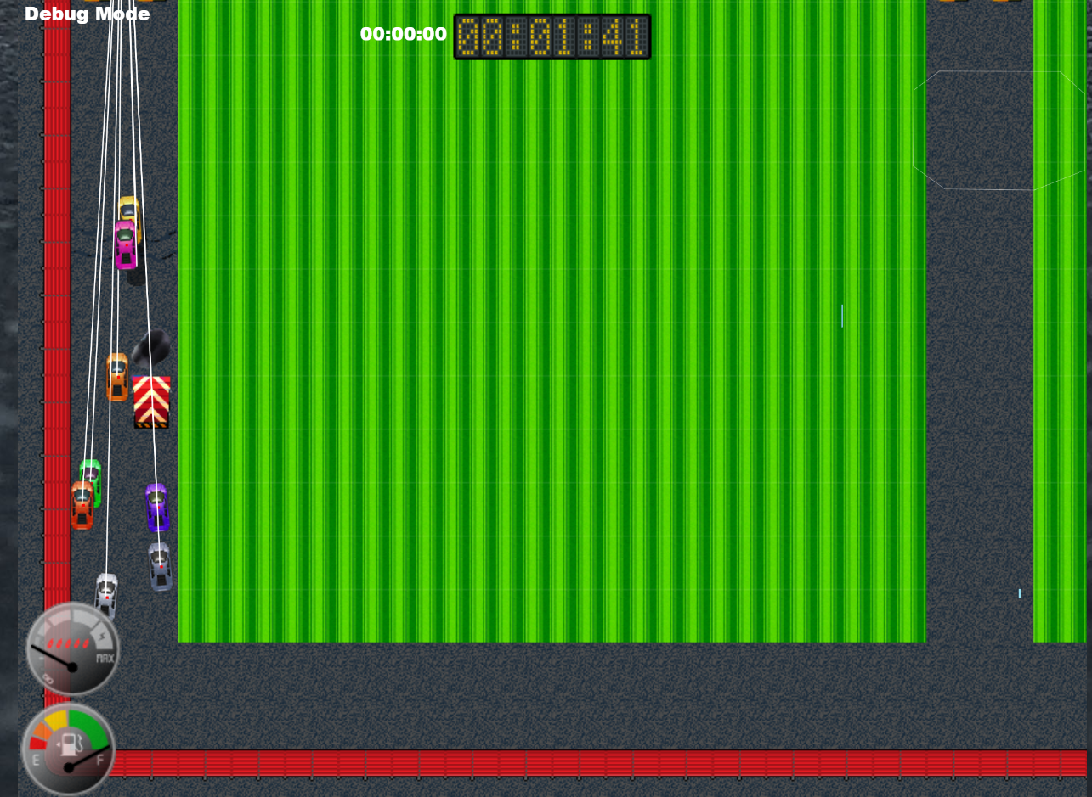
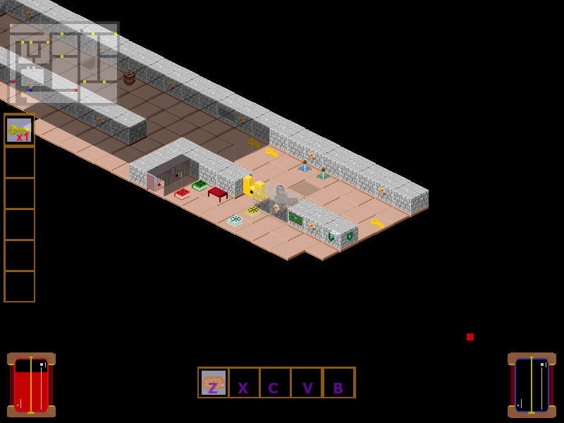
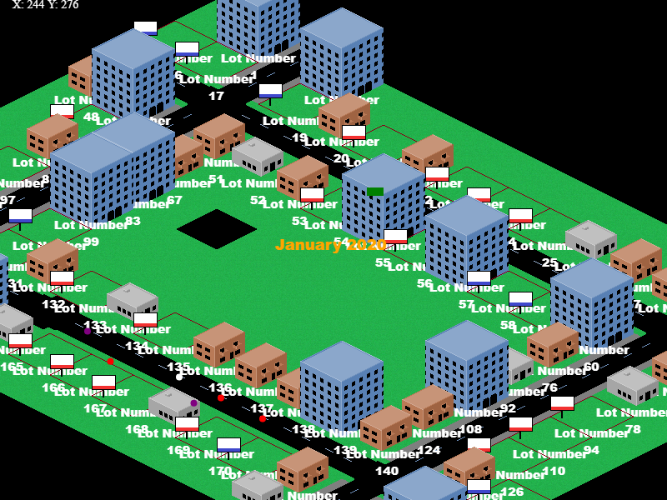
Prior Club Experience
Falldale
Falldale Enhanced Edition
Little Racers
Game Changer
Descend Below the Crypts

Slide 3
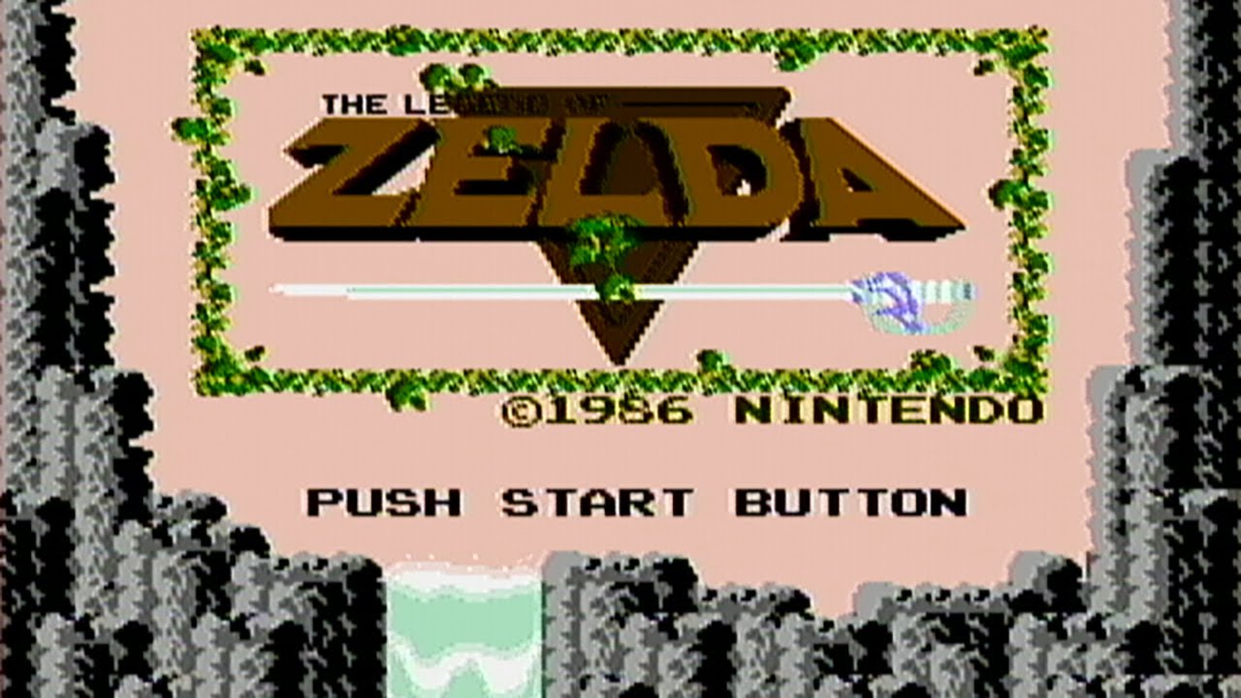
Related Games

Slide 4
Demo
Cutover to Game

Slide 5
Vision
A Top Down RPG Adventure game

Slide 6
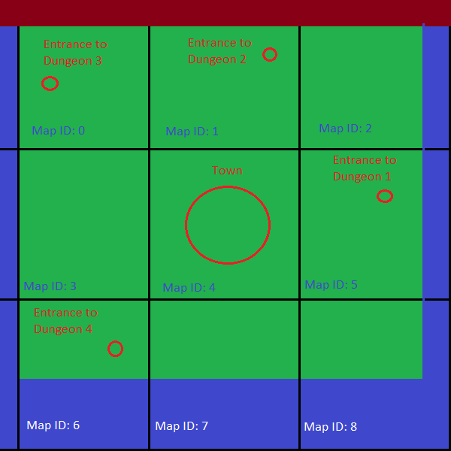
Vision
Dungeon 1: Level 1
World Map
Dungeon 1: Level 2

Slide 7
Schedule
Cutover to Trello

Slide 8
Roles
Art:
Tiles for Dungeons, world map
Monsters, findable ojbects
Sounds:
Character sounds
Background Music
Code:
Artificial Intelligence for enemies
Tile Editor

Slide 9
Questions?
Who would like to take on this adventure with me?

